Slide 1




AIRPLANE ANALYSIS
K.Nandini

Slide 2

Power BI
AS we all know power BI which is most popular and advance tool for analyzing,aggregating,visualizing and sharing data in requried and understanding manner. Data can be exacted from an excel spread-sheet or ciollected from cloud based many other.
In next slide you will see the visualizing
by powe bi based on the given project

Slide 3
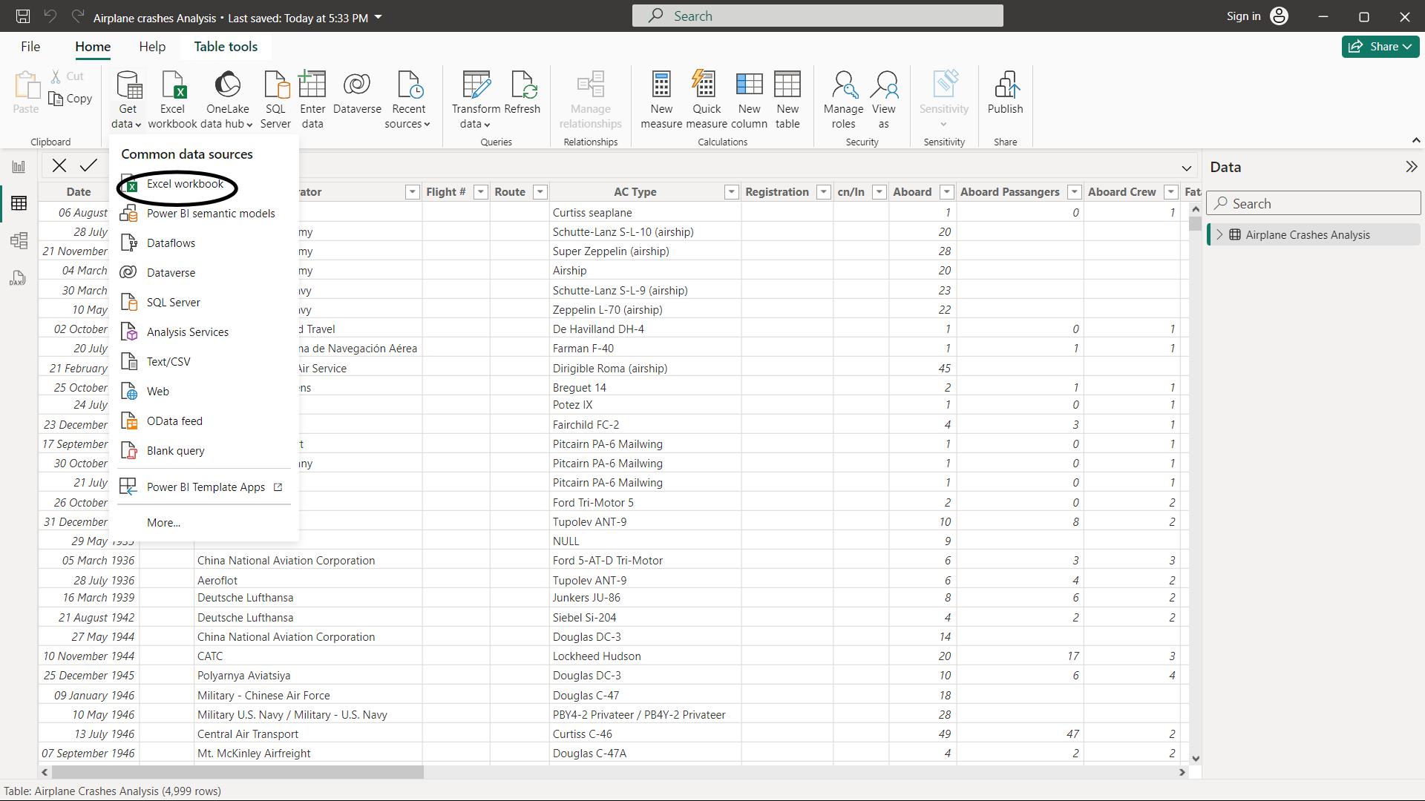

LET’S GOOO....
Here you can observe that how the data is gather by using the option of excel workboomk which is highlighted by black oval
Then later data whichi is load you can use option “TANSFORM DATA”
Where you can apply the cahnges and select the option close and apply present at left above.

Slide 4
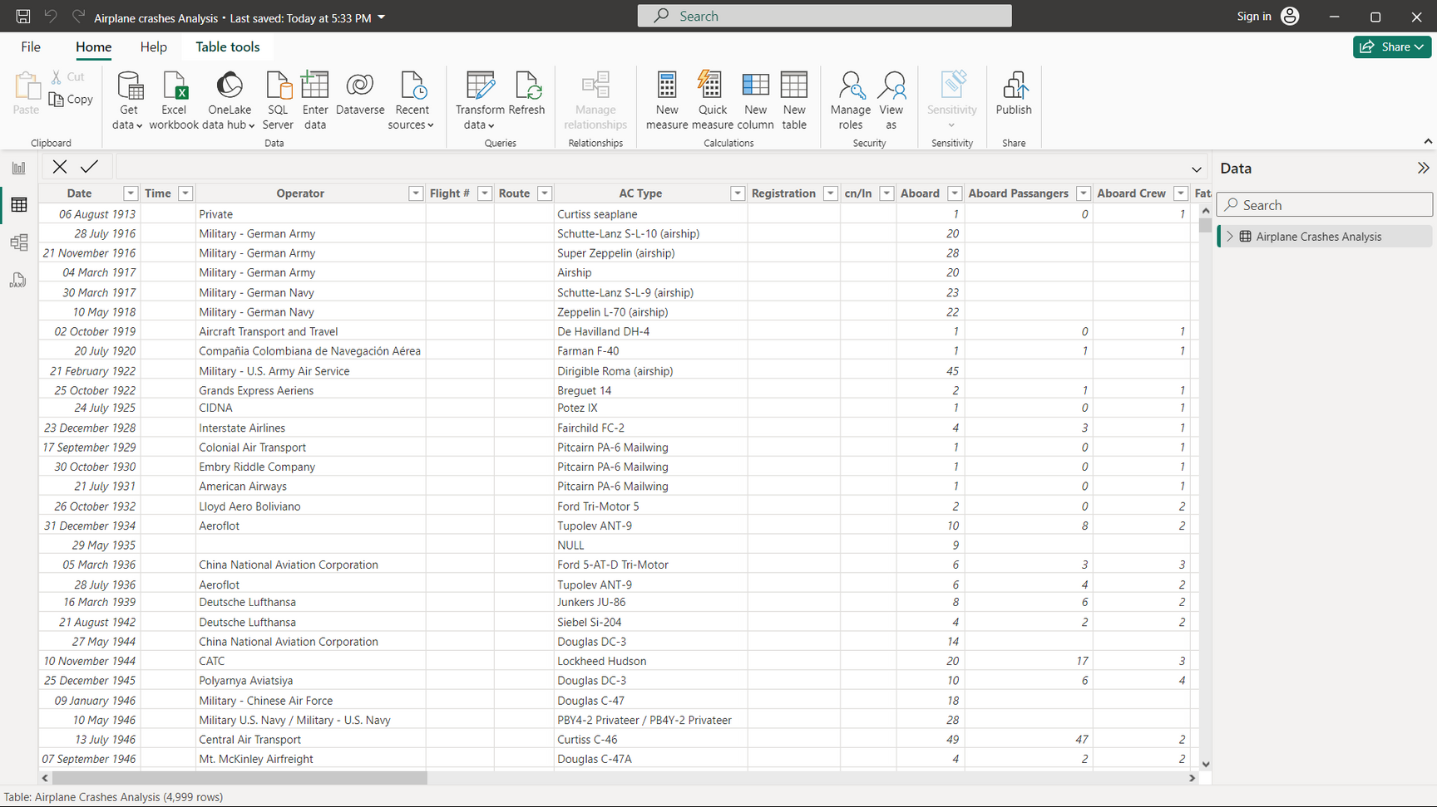







Here we can show
visulizations of data
Here you will observe
the data which
is transformed and
applied further query

Slide 5

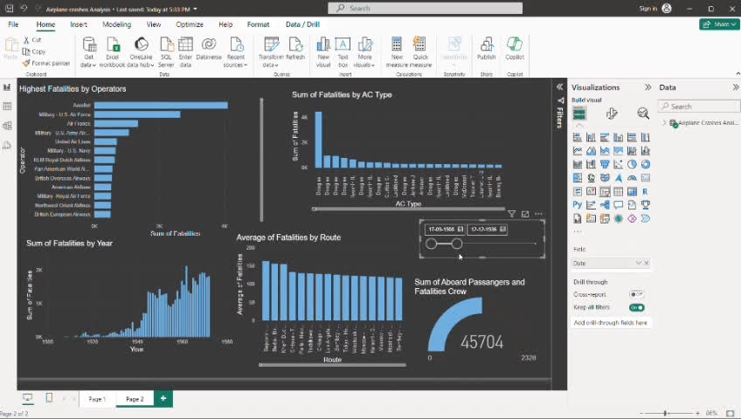


Now we will able to see the visulizing data by moving the slicer according to our required form which is easy to understand and analyzing the data
Slicer which is used to show the data on the required dates , by moving the slicer you will get

Slide 6
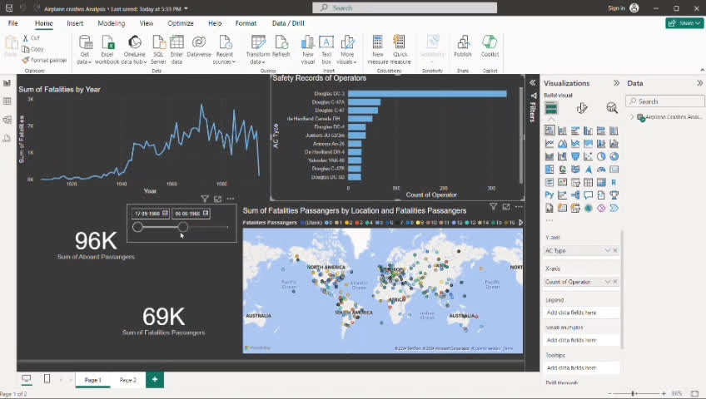
This is the final slide for the visulizing the dataset this is my visulizing for the data you have
*Please delete this section before downloading.
*Please delete this section before downloading.

Slide 7





